Slide 1

Lead &
Opportunity
Scoring
Masters of Data Science Industry Project
2020

Slide 2







Meet the team
Bing Lesley Yuan | Xin Li | Xinhui Lu | Ziyan Zhao | Raelene Huang
Model Developer / Data Analyst | Data Engineer / Scrum Master | Model Developer / Data Analyst | Model Developer / Data Analyst | Model Developer / Team Leader
Limited Resources!

Slide 3
The Client
& Project
Key Research
Question
Data
Methods
Interpretation & Analysis
The Client
Research Collaborations Constituents
Offers research collaboration, consultancy and innovation collaboration to industry partners
Too many opportunities to be handled by Business Development Managers
Scope of the Project
Develop a scoring model to predict opportunity success rates
Gain insights and determine the key drivers of successful opportunities
Limited Resources!

Slide 4


Key Research Questions
What’s the best model to predict successful opportunities?
What are the key drivers for successful opportunities?
Things we cannot control:
Integrity of the data
Lots of missing data entries
Key challenges:
Dealing with many missing data (data cleaning)
Feature selection & transformation
Imbalanced datasets
Other small data problems
Model interpretation and insight analysis
Machine learning Pipeline
Pre-Processing
Model Validation
Model Monitoring
Data Integration
Model Training
Model Deployment
The Client
& Project
Key Research
Question
Data
Methods
Interpretation & Analysis

Slide 5
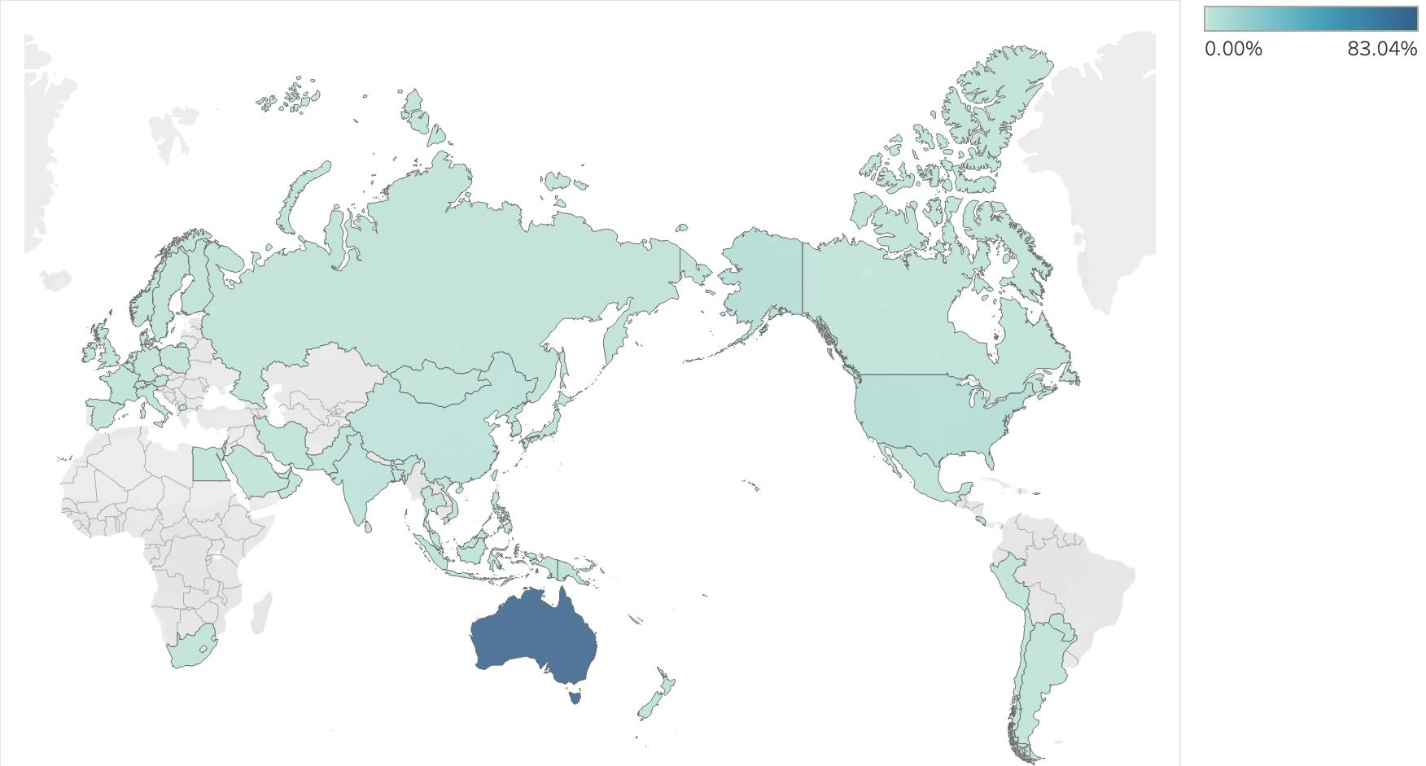
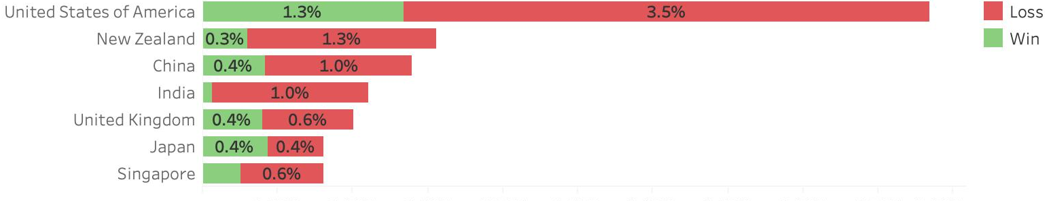

The Research Data
most clients from Australia, US, Europe and Asia
7598 opportunities
5408 opportunities
38 features
19 features
Successfully Converted Rate: 37%

Slide 6
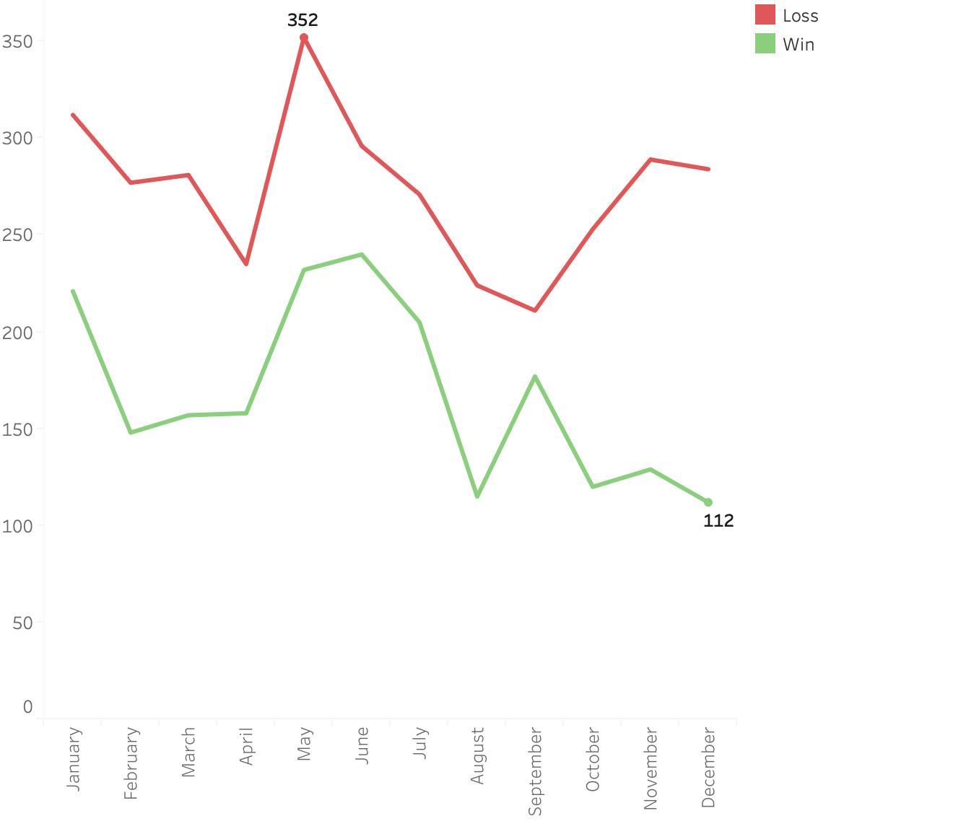
Opportunity
Closed Month

Slide 7
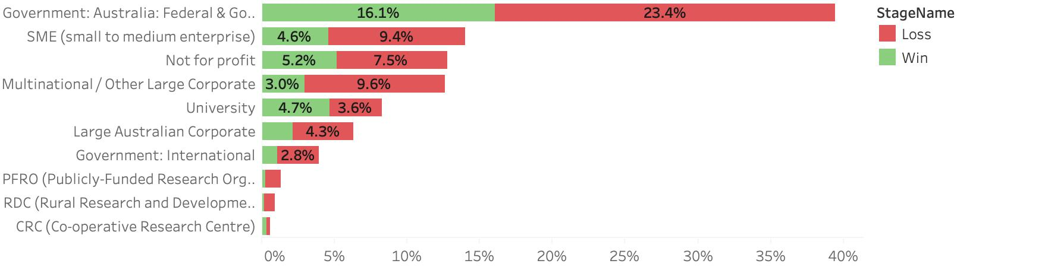

Business Types:
AVG:35%
41% converted
33% converted
57% converted
50% converted

Slide 8
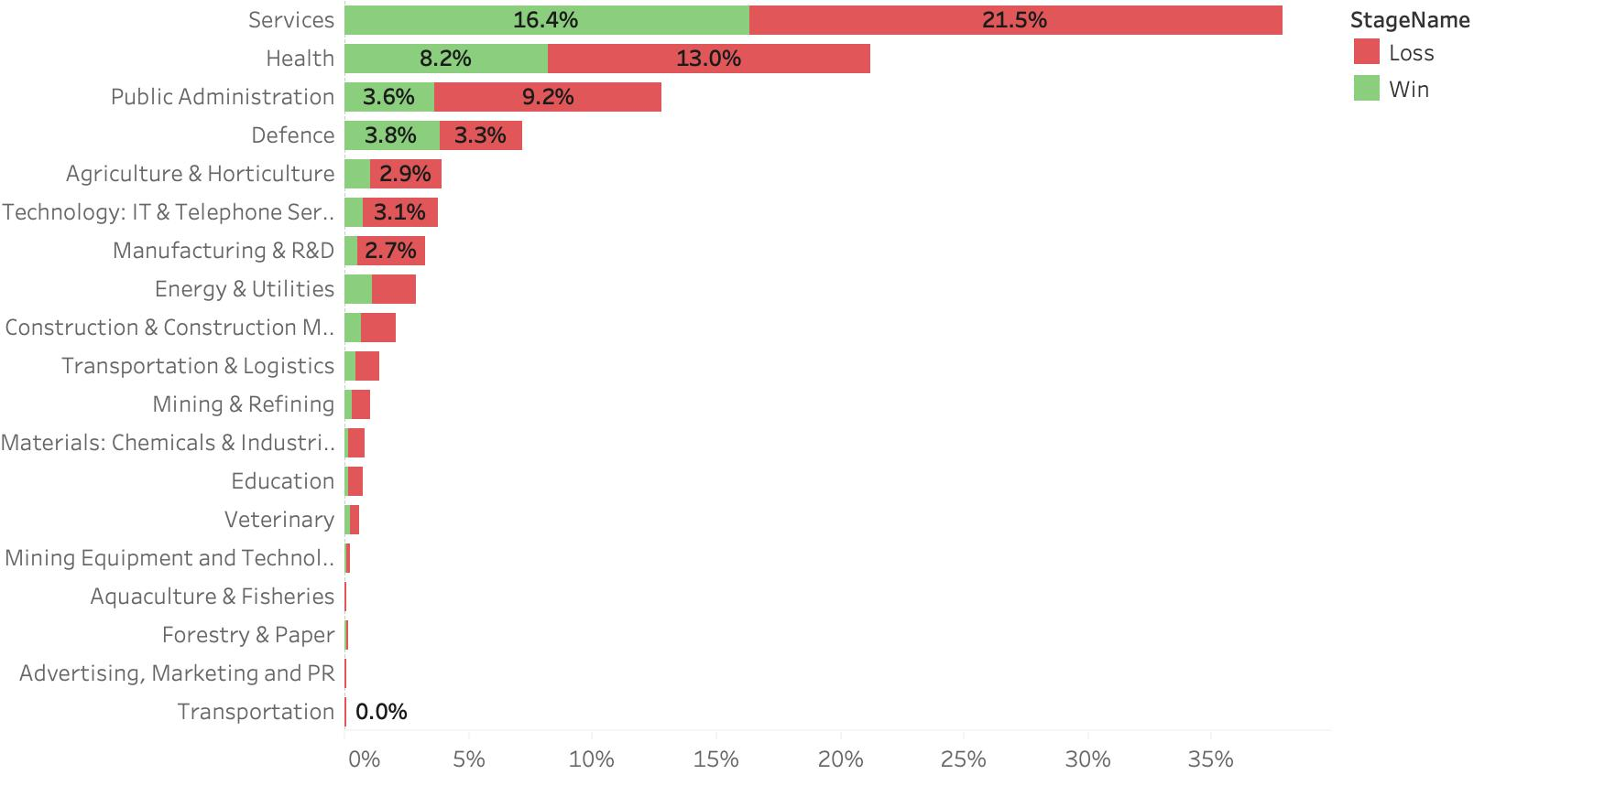
Industry:
AVG: 29%
43% converted
53% converted
18% converted

Slide 9
Features
Account, Opportunity, Tasks and Events
Base Features: Business_Type, Industry, Industry_Sub_Type, Is_External, ParentId, RecordType.Name,
RICE_Supported, Parent_Opportunity, CreatedMonth, CreatedYear, Lead_Faculty, Lead_School,
tasks_events (binary variable)
Cross Features:
opportunity type * industry type (oppo_Industry),
faculty * opportunity type (fac_oppo),
opportunity type * business type (oppo_busi)
Special Features:
RN: The total number of opportunities created with the same account. (i.e. Row Number)
f_won_before: Flag if a previous opportunity has been won with this account before.
Days: How many days were the opportunity opened.
Dataset 1: Base
Dataset 2: Base + special-features
Dataset 3: Base + cross-features
Dataset 4: Base + special-features + cross-features

Slide 10
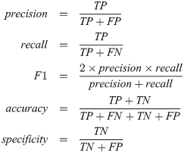
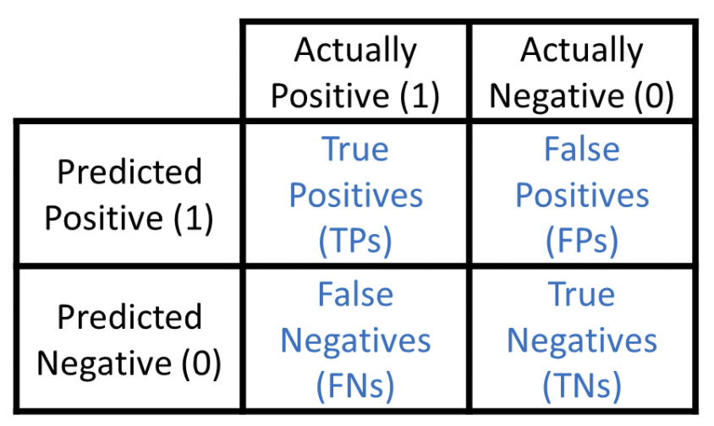
Classification Models
Logistic Regression
Support Vector Machines
Random Forest
Deep Neural Network
Evaluation Metrics
(10-fold cross validation)
Population of Opportunities
Binary Classification Model
Successful
(Positive, 1)
Unsuccessful
(Negative, 0)

Slide 11
Oversampling Data
Unbalanced classes deteriorate model prediction
Successful opportunities were duplicated to balance the dataset

Slide 12
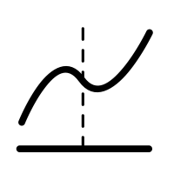
Logistic Regression
01
Why LR first?
High interpretability
Can efficiently describe the relationship between a dependent binary class and the parameters
Examine the Significance of the Features
Give a baseline metric for our latter models
02
Evaluation method
Base (14 variables), additional (3 variables) and cross-features (3 variables)
Dataset 1: Base
Dataset 2: Base + special-feature
Dataset 3: Base + cross-features
Dataset 4: Base + special-feature + cross-features
03
Feature importance
19 variables(columns) and around 300 features
One-hot encoding for categorical variables
Only whose p-value < 0.05 are considered as significant features
Notes:
Script
Hi, I will start presenting the modelling section.
We chose Logistic regression as our first model to give a baseline metric for our latter models, since LR has high interpretability, it can efficiently describe the relationship between a dependent binary class and the parameters and can examine the significance of the features.
Our models run on 4 different combinations of variables from the same dataset to seek the optimum.
Dataset 1 includes the 14 variables in the “Base” section, dataset 2 includes both the “Base” variables and 3 Special-feature variables, dataset 3 contains both the “Base” variables and 3 cross-feature variables, and dataset 4 contains all the variables.
We use R for LR modelling. As we can see from the graph, the result we have cannot prove our assumption that “the amount of feature has a positive impact on the performance of model “. dataset 2 has the highest score in all categories, however, the performance of other dataset is not optimal. Even though dataset 4 has the most features, it only performs slightly better than dataset 1 which has the least feature. On the other hand, dataset 2 and dataset 3 have the same amount of features, but the difference between the results is significant. base on the results, We have noticed that datasets with cross-features tend to have worse performance.
There are 19 variables and around 300 features. The number of features is more than the number of variables because the categorical variables are represented by multiple features as we are using one hot encoding.
We don’t include every feature into the final logistic model. We choose features by their p-value, only whose p-value less than 0.05 are considered as significant.
Next, Xinhui will talk about SVM and random forest.
------------------------

Slide 13

Support Vector Machine
01
Why SVM?
Small and high-dimensional data set (5000+ rows and 15 features)
High Bias & Low Variance
Could use for linear or non-linear data set
Kernel function
simplifies the computational complexity
02
Evaluation methods
All feature sets has the same result
Notes:
Script
Hi, I’m Ziyan. And I will start presenting the binary classification model section. We chose Logistic regression as our first model to give a baseline metric for our latter models, since LR has high interpretability, it can efficiently describe the relationship between a dependent binary class and the parameters and can examine the significance of the features.
Our models run on 4 different combinations of variables from the same dataset to seek the optimum.
Dataset 1 includes the 14 variables in the “Base” section, dataset 2 includes both the “Base” variables and 3 Special-feature variables, dataset 3 contains both the “Base” variables and 3 cross-feature variables, and dataset 4 contains all the variables.
We use R for LR modelling. As we can see from the graph, the result we have cannot prove our assumption that “the amount of feature has a positive impact on the performance of model “. dataset 2 has the highest score in all categories, however, the performance of other dataset is not optimal. Even though dataset 4 has the most features, it only performs slightly better than dataset 1 which has the least feature. On the other hand, dataset 2 and dataset 3 have the same amount of features, but the difference between the results is significant. base on the results, We have noticed that datasets with cross-features tend to have worse performance.
There are 19 variables and around 300 features. The number of features is more than the number of variables because the categorical variables are represented by multiple features as we are using one hot encoding.
We don’t include every feature into the final logistic model. We choose features by their p-value, only whose p-value less than 0.05 are considered as significant.
Next, Xinhui will talk about the model selection.
------------------------

Slide 14
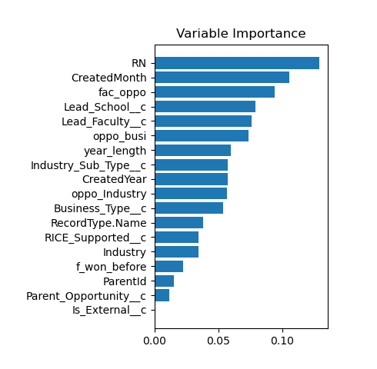

Random Forest
01
Why Random Forest?
No any assumptions for data
No many parameters tuning works
Features importance
Data analysis
02
Evaluation method
Base + Cross-features and All features combined has the same highest performance
03
Feature importance
Notes:
Script
Hi, I’m Ziyan. And I will start presenting the binary classification model section. We chose Logistic regression as our first model to give a baseline metric for our latter models, since LR has high interpretability, it can efficiently describe the relationship between a dependent binary class and the parameters and can examine the significance of the features.
Our models run on 4 different combinations of variables from the same dataset to seek the optimum.
Dataset 1 includes the 14 variables in the “Base” section, dataset 2 includes both the “Base” variables and 3 Special-feature variables, dataset 3 contains both the “Base” variables and 3 cross-feature variables, and dataset 4 contains all the variables.
We use R for LR modelling. As we can see from the graph, the result we have cannot prove our assumption that “the amount of feature has a positive impact on the performance of model “. dataset 2 has the highest score in all categories, however, the performance of other dataset is not optimal. Even though dataset 4 has the most features, it only performs slightly better than dataset 1 which has the least feature. On the other hand, dataset 2 and dataset 3 have the same amount of features, but the difference between the results is significant. base on the results, We have noticed that datasets with cross-features tend to have worse performance.
There are 19 variables and around 300 features. The number of features is more than the number of variables because the categorical variables are represented by multiple features as we are using one hot encoding.
We don’t include every feature into the final logistic model. We choose features by their p-value, only whose p-value less than 0.05 are considered as significant.
Next, Xinhui will talk about the model selection.
------------------------

Slide 15
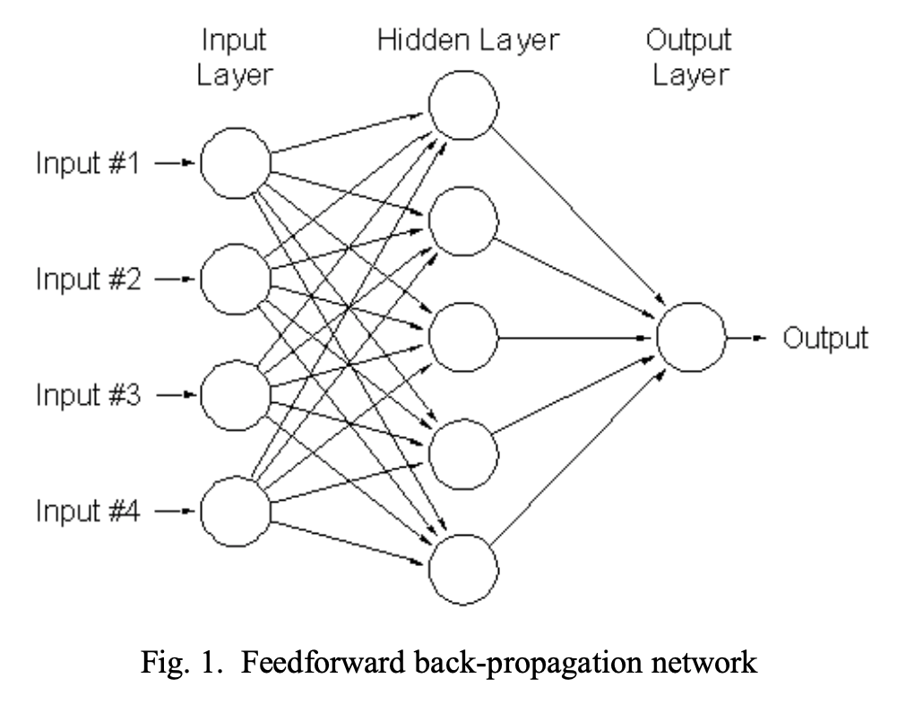
Deep Neural Network
01
Why?
Examine non-linearity in the features.
02
Hyperparameter Tuning
5 hidden layers
256 nodes per layer
ReLu activation function between the hidden layers
Sigmoid output function
03
Evaluation methods
Base + special features has the best performance across all measures
Notes:
Script
Hi, I’m Ziyan. And I will start presenting the binary classification model section. We chose Logistic regression as our first model to give a baseline metric for our latter models, since LR has high interpretability, it can efficiently describe the relationship between a dependent binary class and the parameters and can examine the significance of the features.
Our models run on 4 different combinations of variables from the same dataset to seek the optimum.
Dataset 1 includes the 14 variables in the “Base” section, dataset 2 includes both the “Base” variables and 3 “Additional” variables, dataset 3 contains both the “Base” variables and 3 cross-feature variables, and dataset 4 contains all the variables.
We use R for LR modelling. As we can see from the graph, the result we have cannot prove our assumption that “the amount of feature has a positive impact on the performance of model “. dataset 2 has the highest score in all categories, however, the performance of other dataset is not optimal. Even though dataset 4 has the most features, it only performs slightly better than dataset 1 which has the least feature. On the other hand, dataset 2 and dataset 3 have the same amount of features, but the difference between the results is significant. base on the results, We have noticed that datasets with cross-features tend to have worse performance.
There are 19 variables and around 300 features. The number of features is more than the number of variables because the categorical variables are represented by features as we are using one hot encoding.
We don’t include every feature into the final logistic model. We choose features by their p-value, only whose p-value less than 0.05 are considered as significant. More specific, the the p-value, the more important the feature.
Next, …
------------------------

Slide 16
Comparing All Models
Even though SVM has a precision of 1, it has worst accuracy and recall.
DNN and Random forest has the best and consistent result across all metrics
Column1 | Logistic | SVM | Random Forest | DNN
Accuracy | 0.7345 | 0.6207 | 0.84902 | 0.84399
Precision | 0.6364 | 0.48561 | 0.81627 | 0.79324
Recall | 0.6467 | 1 | 0.88449 | 0.96808
F1_score | 0.6415 | 0.65375 | 0.84902 | 0.87143
Handover to Bing

Slide 17
How to interpret these models?
LIME
Why?
The better performing models are often called blackbox models such as random forests or neutral networks and these models are generally more complex and don’t have a simple way for interpreting their predictions or outcome.
Local interpretable model-agnostic explanations
LIME also makes more human friendly explanations that explanations are selective and possibly contrastive
LIME does work better with models that output probabilities for classification problems
SHAP
Given the current set of feature values, the contribution of a feature value to the difference between the actual prediction and the mean prediction is the estimated Shapley value.
It is also possible to misinterpret shapley value.

Slide 18
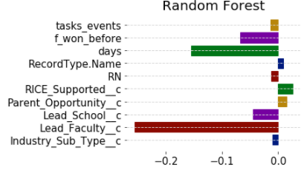
Results - LIME
For this Health research contract opportunities with SME that was closed as lost and it was open for 322 :
• The missing lead faculty value negatively correlates with conversion rate
• High values in days open negatively correlate with conversion rate
• More opportunities created with the same clients may have more negative impact towards the conversion rate.

Slide 19
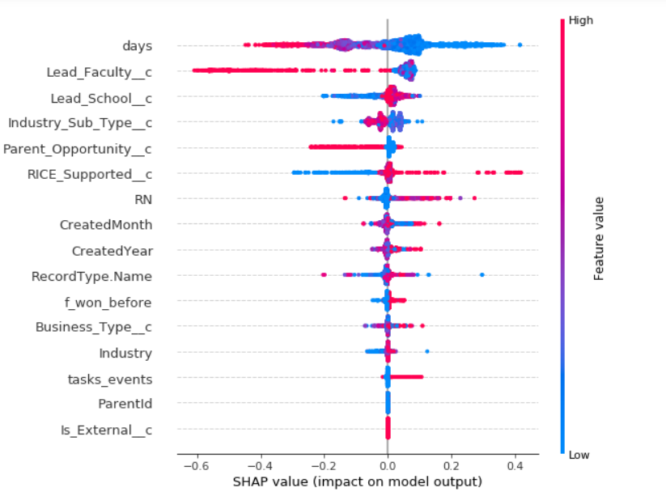
Results - SHAP
Higher probability of closing an opportunity as success within the first 150 days after it was created in the system. The longer it was open, lower the probability of conversion.
While the opportunities are RICE supported, the chances of conversion is much higher than non-supported opportunities.
The grants and co-location opportunities tend to have lower conversion rate compare to technology transfer and sponsorship.
The more opportunities that were created with the same client tend to increase the chance of conversion. However, the success rate would start decreasing from ~200.

Slide 20

Conclusion
What’s the best model to predict a successful opportunity?
Random forest for producing the best results with reasonable computational complexity
Gain insights and determine the key drivers of successful opportunities
Opportunity type
Number of opportunities created with the same client
RICE supported
Days open

Slide 21
THANK YOU!

